Slide 1
Software as a services Installation of Agent and MIN Server
Sreenivasulu Reddy

Slide 2
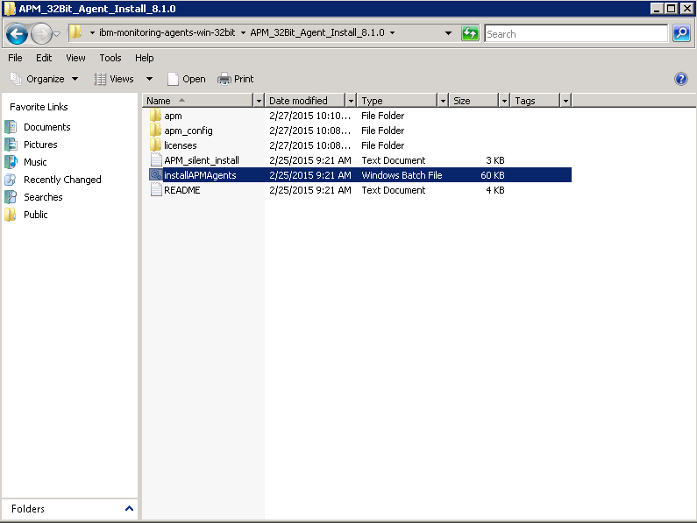
This is explain how you can install SaaS Agent on windows. Go to Agent installer path from command prompt.
Installation of SaaS Agent on Windows

Slide 3
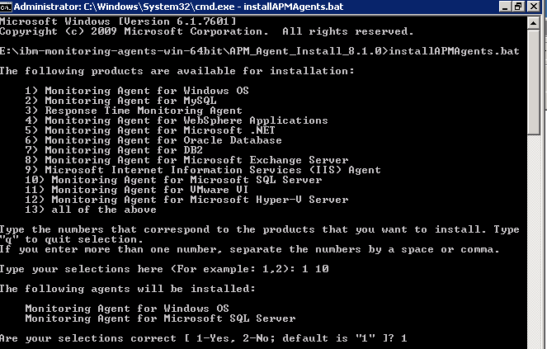
Execute this command ‘installAPMAgents.bat’ it will list out the all available agents then select the agent select types ,if your agent selection is correct then select 1(yes) and specify the installation directory(by default or Manual(D:\IBM\APM))

Slide 4
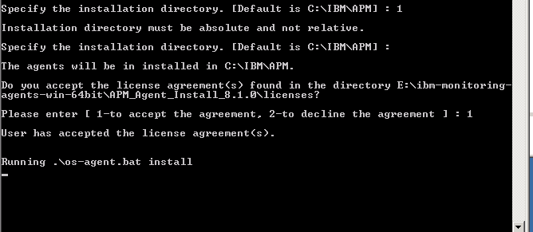
For license agreement accept select 1(yes) then enter tab installation will be started. When you run the batch file with “install” option it runs the prereqcheck first and then runs the installation. If prereqcheck is not required. Set SKIP_PRECHECK env variable to Y to proceed without precheck. This before running <your-agent>.bat run following command SET SKIP_PRECHECK=Y

Slide 5
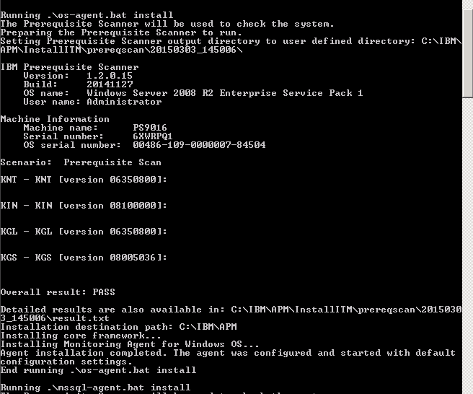
Prerequisite scanner and OS Agent is completed successfully

Slide 6
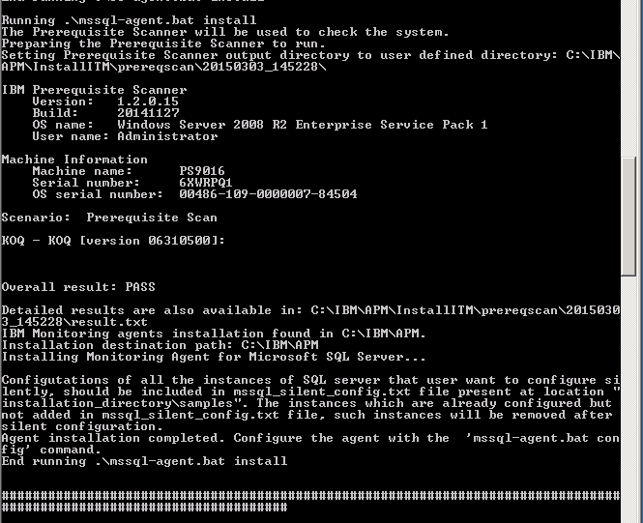
Prerequisite and SQL SaaS agent is installed successfully

Slide 7
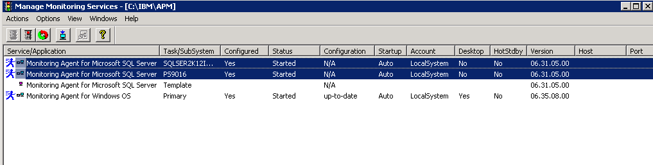
Configure Instances on MTEMS window and then start the agent . Check the required XML files are generated in candle home path i:e ‘C:\IBM\APM\localconfig’ file. If its downloaded all required XML files on Agent machine then we can able to see instance data on APMUI Portal. Or else we can able to see our instances data on portal.

Slide 8
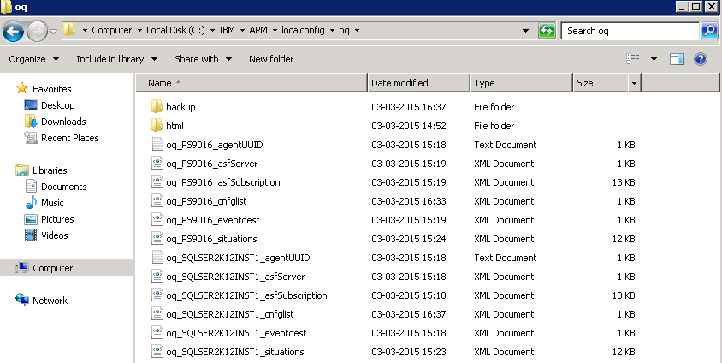
See the above screenshot for OQ agent XML files.

Slide 9
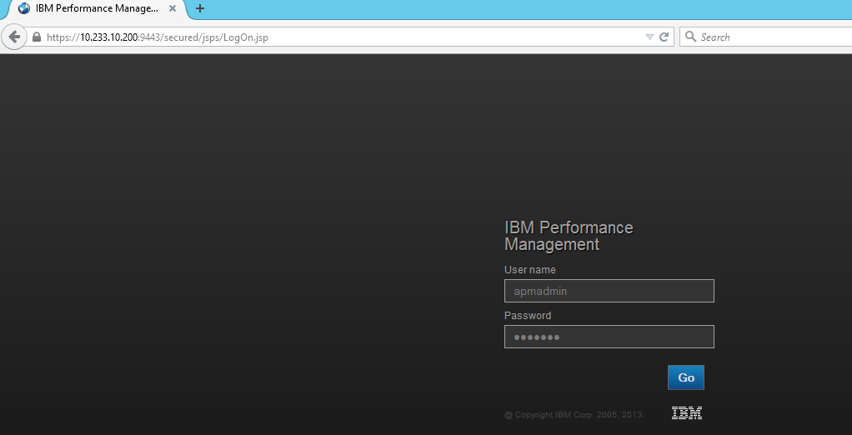
The configuration completed. Rest of the configuration needs to be done from the UI. Login to UI https://server:9443 to start the configuration wizard Give the User name and password of IBM Performances portal and click on GO button.(Default credential of user name: apmadmin ,password: apmpass

